Slide 1

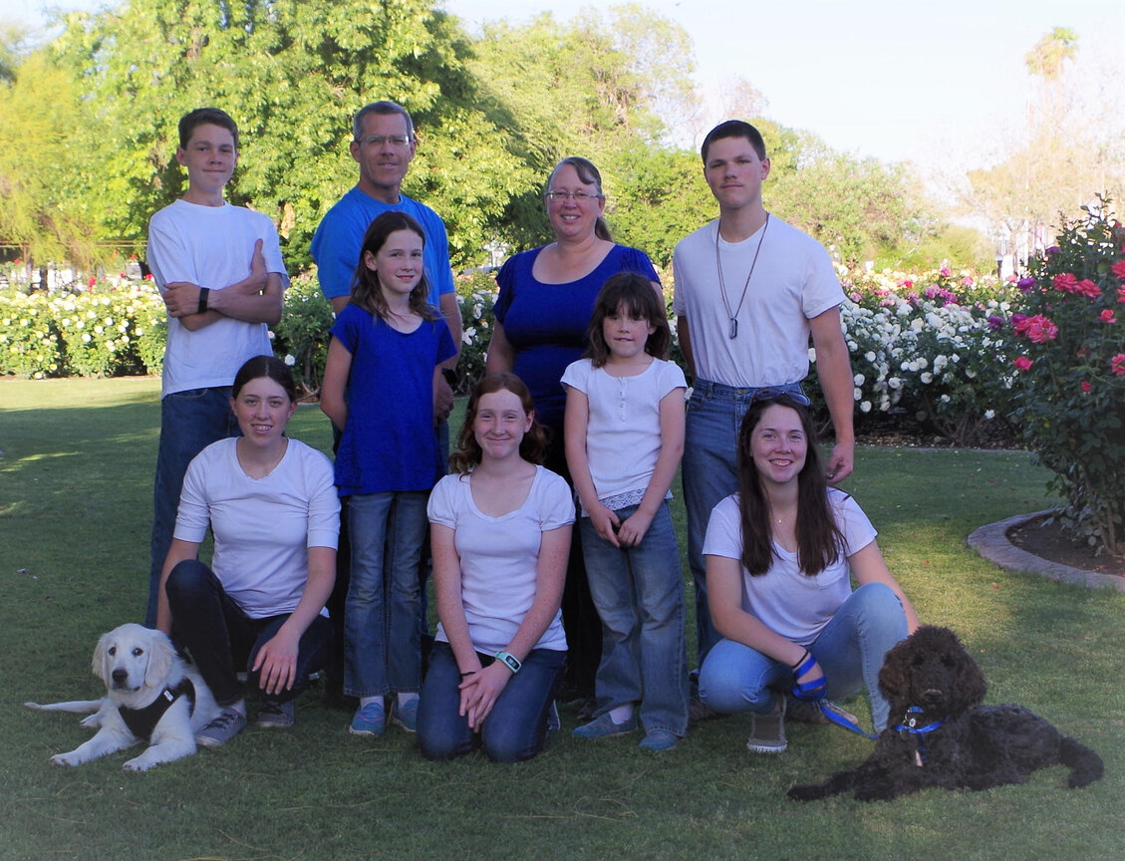
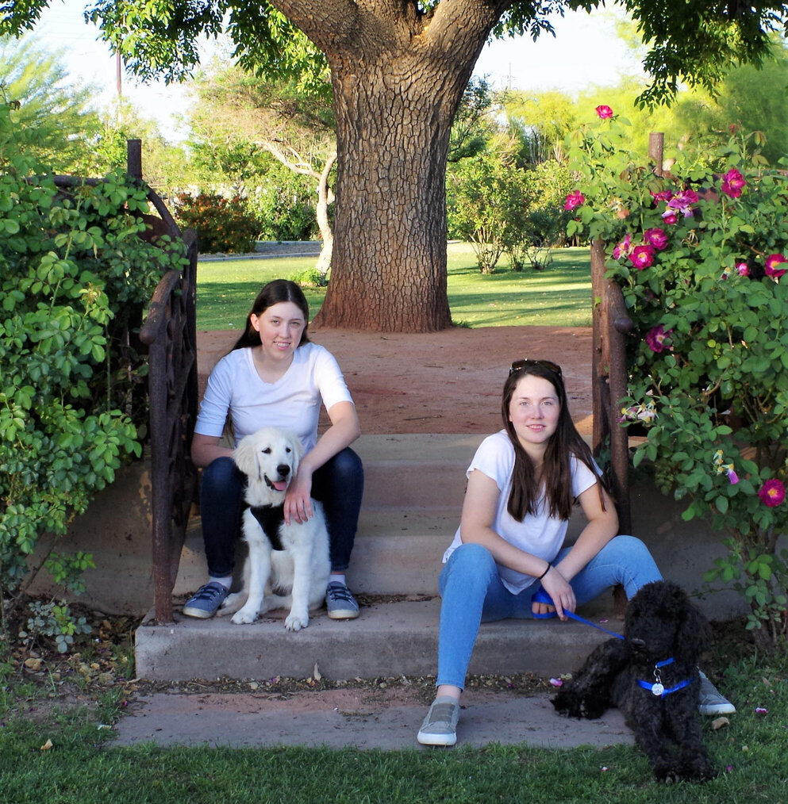
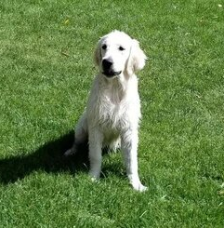
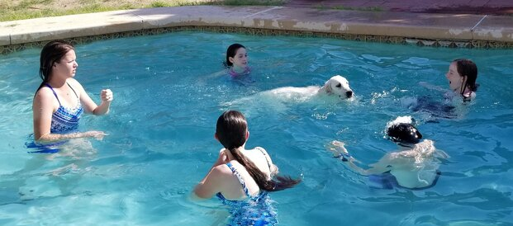


Home FAQ Contact Us
About Parents Available Litters
Cookies and Cream Doodles
About Us
We are a family located in Mesa, Arizona that breeds goldendoodles. We adopted a beautiful AKC registered English cream golden retriever puppy and a handsome AKC standard brindle poodle. After adoption, we felt that their bloodlines were too good to not allow them to be passed on. We subsequently decided to raise them together and breed them with each other to create the popular designer breed dog known as a goldendoodle.
Teddybear Goldendoodles
Goldendoodles are a mix of golden retriever and poodle. This mix can involve a standard poodle, mini poodle, or toy poodle. Currently, Cookies and Cream Doodles only breed standard sized goldendoodles. Our doodles will grow to be between 50 and 70 pounds. When a poodle is bred with an English cream golden retriever, rather than a standard golden retriever, the resulting goldendoodle is known as a teddybear goldendoodle or English cream goldendoodle. These goldendoodles are known for their blocky conformation that gives them the classic teddybear look that many individuals are very fond of. These dogs are very intelligent, with golden retrievers and poodles both being
known as very smart dog breeds, and very loving. However, both dog breeds are very friendly, so they generally go not make good watch dogs. Goldendoodles generally live around 10 to 15 years. There biggest draw is their hypoallergenic hair. They inherit this hair from their poodle parent and will shed little or not at all. This is perfect for people with allergies to dog fur. Goldendoodles also have what is known as hybrid vigor. Since they are bred from two completely unrelated dogs, they tend to be healthier than a strictly purebred dog that may be bred from closely related parents.
For more information about our business, please visit our FAQ page. Our planned litter page will show any current litters as well as available puppies. If you wish to be added to our waitlist or if you have any questions, the contact us page will help you get in touch with us.
Email: C&Cdoodles@gmail.com
© 2021 Cookies and Cream Doodles

Slide 2
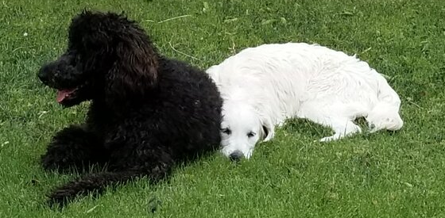
Home FAQ Contact Us
About Parents Available Litters
FAQ
How much do you sell each puppy for?
We sell the males for $2500 and the females for $3000. This price is subject to change for puppies that are certain colors.
Do you provide discounts if a family purchases multiple puppies?
No. It is very difficult to care for more than one puppy at a time, so we require full price for all puppies in order to encourage families to think carefully about adopting more than one puppy at a time.
Do you early spay/neuter your puppies?
We do not. We believe that dogs need the hormones in order to grow correctly. We recommend that the puppies be spayed/neutered around the time that they turn one.
Do you offer breeding rights
Yes. We do not require a spay/neuter contract or charge extra for breeding rights. We believe every family can make the decision to breed or not breed their own puppy.
Do you ship your puppies?
We do not currently ship puppies. If you wish to purchase from us, you will need to make arrangements to travel to Arizona and transport the puppy back home with you.
Do you remove dewclaws and dock tails?
We do not remove dewclaws. We have observed our dogs in day-to-day life and fully believe that dewclaws are necessary in order to allow them to function. We do not dock tails because we like the long, full tails of our dogs.
What vaccines and dewormings do puppies receive before going home?
All puppies receive their first shots around 7 weeks. They are also dewormed every two weeks starting a 2 weeks.
Where are the puppies raised
The puppies are born and raised in our home, and we handle and love them from day one.
Email: C&Cdoodles@gmail.com
© 2021 Cookies and Cream Doodles

Slide 3
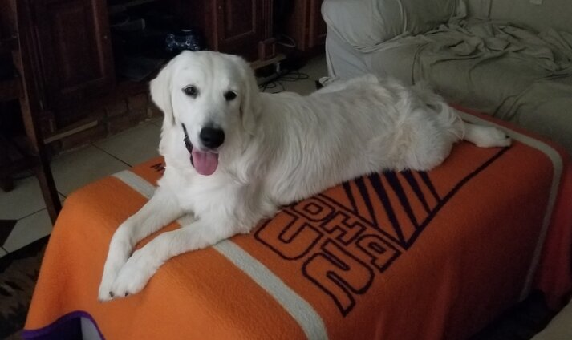
Home FAQ Contact Us
About Parents Available Litters
Contact Us
Enter your information below and compose your message. Feel free to ask any questions that haven't been answered by the FAQ page. You can also request to be placed on the waitlist. When you are done composing your message, click send email.
Email
*Please double check to ensure you entered it correctly
First Name
Last Name
Message
Send Email
Email: C&Cdoodles@gmail.com
© 2021 Cookies and Cream Doodles

Slide 4
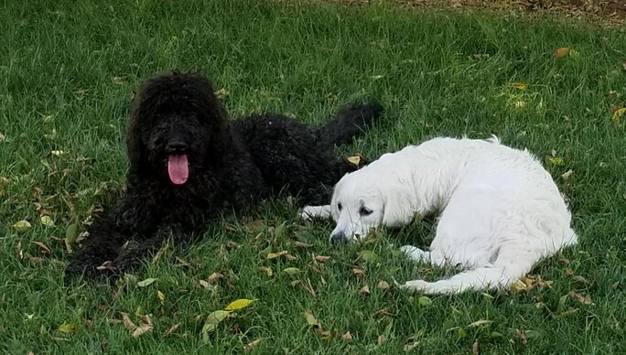
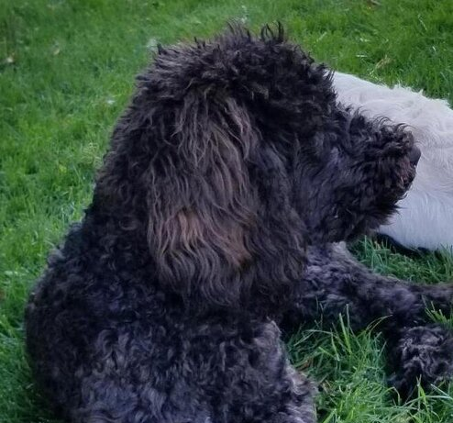
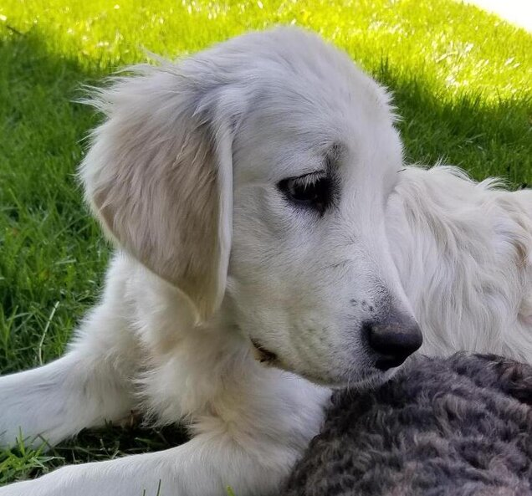

Home FAQ Contact Us
About Parents Available Litters
About Parents
Axel
Axel is an AKC Standard Poodle. He is brindle with black, brown, and silver coloring throughout his coat. He also has a lovely white blaze on his chest. His father is a brindle, parti poodle who regularly throws parti, phantom, and brindle puppies. Axel is a very active dog who loves to run whenever he gets a chance.
Weight: 55 Pounds
Height: 26 Inches
Misty
Misty is an AKC English Cream Golden Retriever. Her coat is a beautiful white color. She has wonderful blocky conformation and beautiful black eyes and nose. She is an intelligent and friendly dog who loves to spend time with her family. Misty loves to run, swim, and chill on the couch.
Weight: 55 Pounds
Height: 22 Inches
Xena
Xena is an AKC Newfoundland. She has a lovely Landseer, black and white, coat. She has two black sleeves, one on a front leg and the other on the opposite back leg, with matching white paws. She is an absolute sweetheart who loves to cuddle despite how big she is.
Weight:
Height:
Email: C&Cdoodles@gmail.com
© 2021 Cookies and Cream Doodles

Slide 5
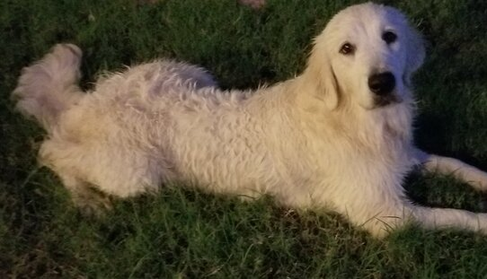
Home FAQ Contact Us
About Parents Available Litters
Available Litters
Misty + Axel
F1 English Teddybear Goldendoodles
Litter expected Fall 2022
Estimated Size: 45-60 Pounds
Female #1
Female #2
Female #3
Female #4
Male #1
Male #2
Male #3
Email: C&Cdoodles@gmail.com
© 2021 Cookies and Cream Doodles

